Slide 1
CLOUD COMPUTING INTERNSHIP
NEEMiiT Private Limited Software Company
PRESENTATION
PRESENTED TO : Pooja Neemkar
PRESENTED BY : GROUP 6
TEAM LEAD : B.SOWMYA RAJI
MEMBERS :SD.SHARMILA
M.TEJASWINI

Slide 2
AWS SERVICES
HANDS-ON AND PRESENTATION
S3
DynamoDB
EC2
4. RDS
5. AWS Budgets
Sowmya
Sharmila
Tejaswini

Slide 3
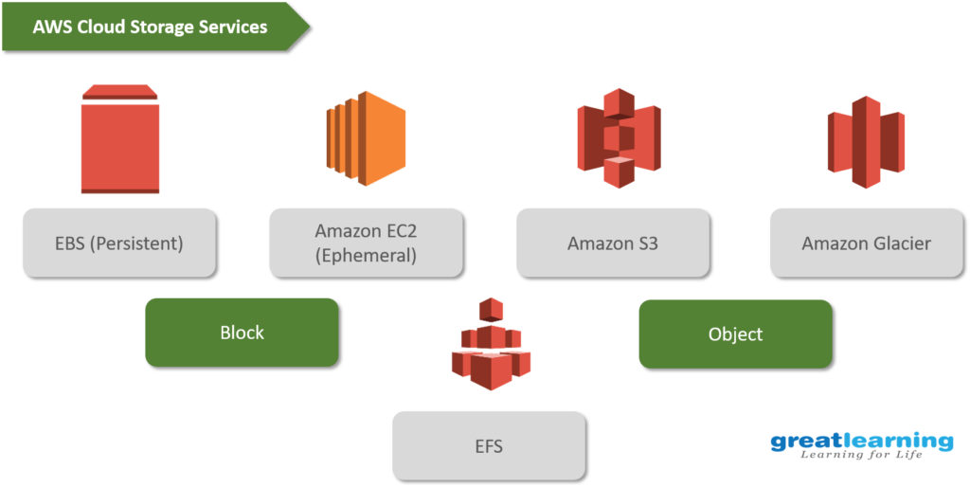

Slide 4

AMAZON S3

Slide 5
S3 stands for Amazon Simple Storage Service.
It is a cloud-based object storage service that offers industry-leading scalability, data availability, security, and performance.
You can use Amazon S3 to store and retrieve any amount of data at any time, from anywhere

Slide 6
S3 is a popular choice for a variety of use cases, including:
Data storage
Backup and disaster recovery
Web hosting
Data lakes
Content delivery

Slide 7
BENEFITSOF S3:
DURABILITY
COST-EFFECTIVENESS
SCALABILITY
PERFORMANCE
SECURITY

Slide 8
HANDS-ON:
Show how to Create bucket in s3 & Host a static simple website and verify in browser
STEPS TO CREATE S3 BUCKET AND HOST A STATIC SIMPLE WEBSITE:
1.Create a bucket
2.Upload index.html & error.html into bucket
3.Under “Properties” > Static website hosting - enable
4.Under “Permissions” > Block public access (bucket settings) – mark it as off
Edit bucket policy –
{
"Version": "2012-10-17",
"Statement": [
{
"Sid": "AllowPublicAccesstoObjects",
"Effect": "Allow",

Slide 9
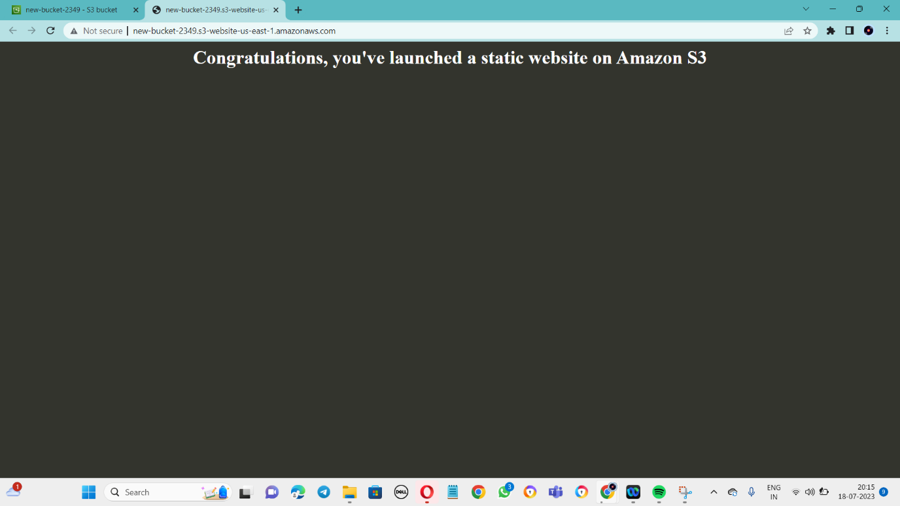
"Principal": "*",
"Action": "s3:GetObject",
"Resource": "YOUR-BUCKET-ARN /*"
}
]
}

Slide 10
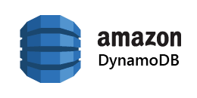

Slide 11
Amazon DynamoDB is a fully managed NoSQL database service that offers high performance, scalability, and durability.
It is a key-value and document database that can be used to store a wide variety of data, including:
Customer records
Product inventory
Order history
Financial transactions
Logging data
Any other type of data that you need to store and retrieve quickly and easily

Slide 12
Here are some of the use cases for DynamoDB:
E-commerce
Social media.
Gaming
Log analytics
Any other application that requires high throughput and low latency.

Slide 13

HIGH THROGHPUT &
LOW LATANCY
MANAGED
SCALABILITY
SECURITY
DURABILITY

Slide 14
HANDS-ON:
Show how to Create Dynamo table with few items
Steps to create Dynamo table with few items:
Go to the AWS Management Console and sign in to your account.
In the search bar, type "DynamoDB" and click on the "Amazon DynamoDB" service.
Click on the "Create Table" button.
Give Table name- EX: Movies
Partition key EX: Title (Data type: String)
Click on the "Create" button to create the table.The Table will be created

Slide 15
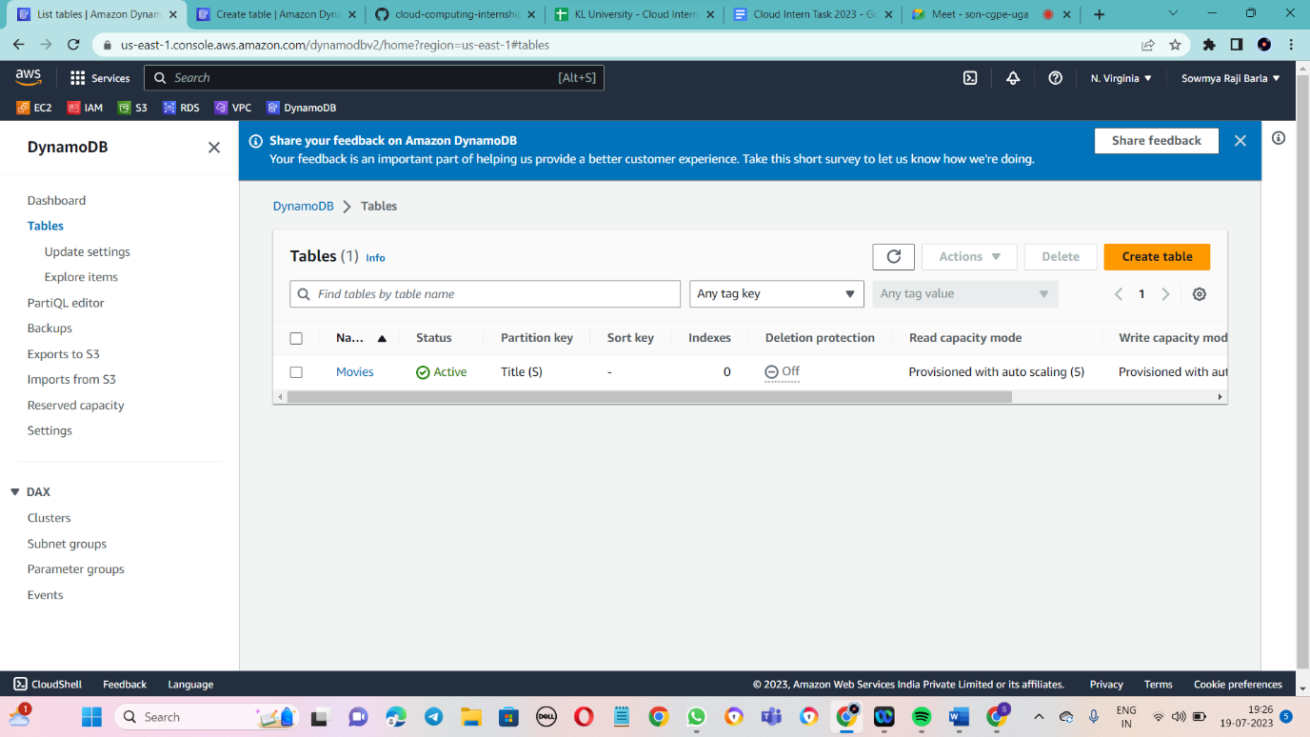
6.If you want to enter any elements in the table you should run commands in cloud shell
Example: aws dynamodb put-item --table-name Movies --item '{"Title": {"S": "The Godfather"}, "Year": {"S": "1972"}, "Rating": {"N": "9.2"}}'

Slide 16
CONCLUSION:
If you are looking for a scalable, durable, and secure object storage service, then Amazon S3 is a good option.
If you are looking for a scalable, durable, secure, and managed NoSQL database service, then Amazon DynamoDB is a good option.

